Slide 1
Beyond Robert’s Rules
People, process and productivity
A presentation by Peter S., NYC

Slide 2
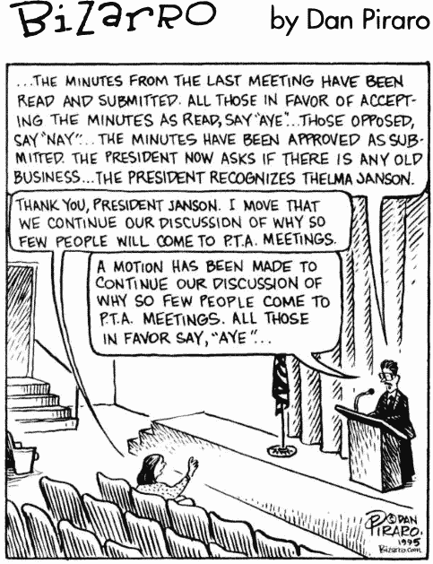
We know what bad looks like!
This is a general observation, not a comment on this conference
What does good look like?
How do we get there?

Slide 3
Robert’s Rules
What kind of people were Robert’s Rules written for?
Henry Robert was an army officer writing for other army officers, trying to keep them from killing each other in post Civil War legislatures
He based his procedures on English parliamentary procedures
Where did English parliamentary procedures come from?
They were developed over many centuries by the Celts, the Romans, the Saxons, the Vikings and the Normans, to stop army officers from killing each other in legislative sessions
Who uses Robert’s Rules? The US Congress. Unmodified, it is a recipe for factionalism and conflict; this is why we have substantially modified it for our own legislative sessions
It is neither designed nor suitable for a working committee

Slide 4
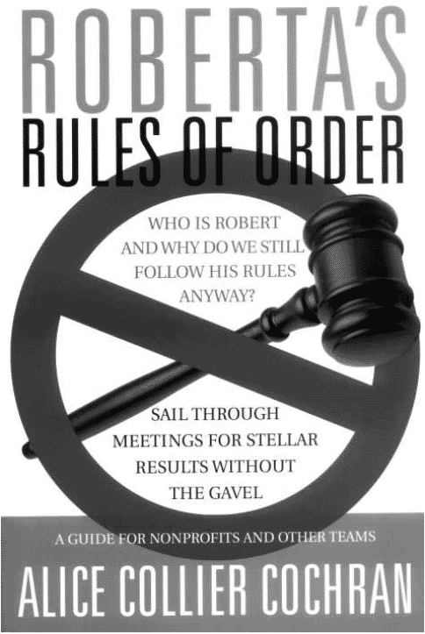
Robert’s Rules of Order
Alice Collier Cochran:
Roberta’s Rules of Order: Sail Through Meetings for Stellar Results Without the Gavel
Paperback $23
Kindle $18

Slide 5
Roberta's Rules
Not rules at all, actually
Suggestions and guidelines for small non-profit boards:
Decision making
Planning and running meetings
Keeping discussions focused and productive
Designing the organization's structure (governance and by-laws)
It is built around principles that will be comfortable to everyone in the program:
Inclusion
Consensus
Vision
If you are here, it is because you are interested in how to run a small non-profit board: buy the book and read it!
This is my recommendation, I am not suggesting UA endorse this book

Slide 6
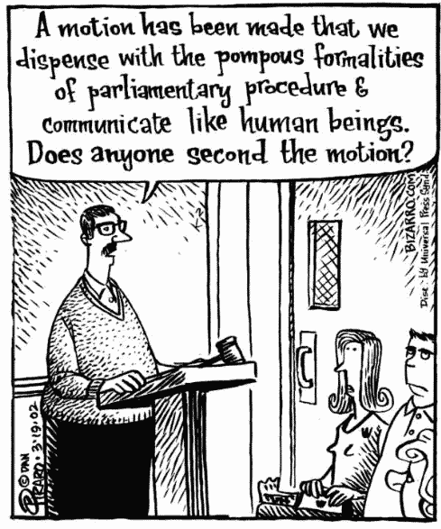
So what do we do now?

Slide 7
Committees & Meetings
We have set up a whole bunch of committees to go away and do the work of the WSC between now and next year
We did the same thing last year; only five of the twelve committees we set up then even met; only two presented substantive work product at the conference
How do we make it different this year?
If there are rules for making a committee work, or a magic wand we can wave to make it happen, please let me know!
In the meantime, here are my suggestions, based on:
Things that some very successful businesses do
Things that we do in our recovery from underearning
Things that appeared to work with the Literature Committee

Slide 8
The Cost of Committee Meetings
There are no rules, but there is one thing to keep in mind!
In the business world, group meetings are seen as very expensive, whether in person or on the phone
With that in mind, we need to use them for the things that we most want to get done:
Brain-storming
Coming to agreement
Everything else can be done offline:
Reading things out
Doing the things the group has agreed needs to be done
Role-playing nineteenth century army officers and US Congressmen
Add up the hourly rate of everyone
at the meeting, multiply by the length of the
meeting: that is the cost of the meeting; if travel or
other costs are involved, add those as well

Slide 9
Productivity
To be productive, we need to look at:
If we focus only on process, without regard to people, we cannot be productive
PROCESS
PEOPLE

Slide 10
Underearners Anonymous
What kind of people are we?
The bad: what are our symptoms?
The good: what are our principles?

Slide 11
Underearners Anonymous
Symptoms of underearners:
Self will run riot
Stinking thinking
Staying in the cave
Not having a voice
Over volunteering
Squandering time
Feeling worthless
Stability boredom and disruption
Not following up
We need to put guardrails around ourselves!
These are a few of my own suggestions—please add your own!

Slide 12
Underearners Anonymous
Program principles:
One step at a time
Let go and let God
Progress not perfection
Principles over personalities
Steps, Traditions, Tools
H.A.L.T.
Clarity, accountability, responsibility, willingness
Vision, goals, actions
If you don't know where you're going, how are you going to get there?
We need to make sure our processes are consistent with our principles!
These are a few of my own suggestions—please add your own!

Slide 13
Running Committees The UA Way
Visions ➔ Goals ➔ Actions
First we come to agreement on our overall vision and approach
Then we come to agreement on the goals/problems to be solved
Then we come to agreement on the relative priorities of the goals/problems to be solved
Then we take actions on our prioritized goals
Inclusiveness/Having a voice:
Gathering input on issues from as many people as possible
Making sure everyone gets a chance to express their views/opinions on issues

Slide 14
Running Committees The UA Way
Time awareness:
Timed agendas
Time keeping in meetings
Keep It Simple:
Brief meeting minutes
Who was there?
What was decided?
What actions/tasks were agreed (who, what, by when)?
Not every issue needs a new policy, a new by-law or even a new action
Some things just need gentle honesty and thoughtful answers

Slide 15
Running Committees The UA Way
Clarity:
Clear agendas
When/where will the meeting be? (Including phone bridge access codes)
What is the meeting format?
What will we talk about/what decisions will be made?
Documentation of work effort and results
One step at a time (exertion exhaustion)
Divide tasks up into small, achievable actions
If I am the only person doing the work, then my first action on my list must be to find someone else to take the second action

Slide 16
Running Committees The UA Way
Service
Service means doing what you are told
It does not mean telling people what to do!
The inverted pyramid of UA Service
We serve the Fellowship: they are our bosses!
We need to make sure that we are accountable to them
We need to make sure that they have visibility into what we are up to

Slide 17
Running Committees The UA Way
A searching and fearless moral inventory
Many of us have experience of other recovery programs
Different programs do different things, and do the same things in different ways
We cannot expect or assume that the way we did something in another program is the right way to do it for UA

Slide 18
Running Committees The UA Way
This list is by no means all there is!
I add something every time I look at it!
So now the people on the committee need to come to agreement on the processes for the committee, bearing in mind:
Our strengths
Our weaknesses

Slide 19
Roles
Who are the most important people on the committee?
The Committee Members!
The people who actually do the work of the committee
We have to show up! Nothing will get done if we don't
We have to speak up! Nothing will get done right if we don't
We have to take on actions that we can handle Once again, nothing will get done if we don’t
We have to be clear about the actions that we can’t handle—we all have day jobs and other service commitments
Program principles: slice up actions into tasks that are small enough to be manageable

Slide 20
Roles
…but how do we keep the meetings themselves on track?
Tradition Keeper
Making sure the meeting sticks to the agreed upon format
Making sure everyone gets a fair say
Since the Tradition Keeper cannot easily participate in the discussion, this position can be rotated
(This role is also called Parliamentarian or Egalitarian, but Tradition Keeper seems most in keeping with UA principles)
Time Keeper
Making sure the meeting stays on track time-wise
Since the Time Keeper cannot easily participate in the discussion, this position can be rotated

Slide 21
Roles
Secretary
This role maintains Clarity
Taking concise accurate notes
Distributing meeting notes and agenda promptly
Keeping track of things that need to be kept track of
…and finally, the Chair
This is UA: the Chair is not the “Leader” but the “Facilitator”
Main jobs: recruiting, getting people involved, keeping people motivated, chairing meetings
NOT doing the work of the committee, but making sure it gets done
NOT making the decisions for the committee, but making sure they get made

Slide 22
Substantial Agreement
A motion is an action, a solution to a perceived problem
Before we can agree on a solution, we need to agree on the problem!
Problem Space
Solution Space

Slide 23
Substantial Agreement
How do we do that, how do we come to consensus?
What is a space and why is it diamond-shaped?!
Step 2:
Start narrowing the discussion
This is the hard part—this is where we start agreeing!
Organize and summarize the information
Discuss and judge different possibilities
Drop some ideas or options in favor of others; straw polls help here
Narrow the possibilities to two or three or four clear-cut options
Be clear about the advantages and disadvantages of each option
Step 1:
Open the discussion
Keep an open mind
Gather information
Get as many viewpoints as possible
Do not discuss or try to judge individual suggestions at this stage!
Step 3:
Close the discussion
Come to a decision between the various options
This is the easy part: we are choosing between a few options, with a clear picture of each
Don’t forget to negotiate!
This doesn’t have to be either/or—it may be possible to do both, taking the best pieces of each option
1
2
3

Slide 24
A UA Approach to Motions
So how do we frame our suggestions, so that we can agree on the problem as well as the solution?
A suggestion from Roberta’s Rules – this is only one approach of many!
Six steps to presenting a simple, stated proposal:
State the suggestion verbally to the group, and explain the need.
Clarify by answering questions for understanding.
Check for disagreement (objections); if none, then check for agreement. (Stop at this point if everyone agrees to the proposal!)
If there are objections, clarify issues as necessary and ask for statements of both pros and cons.
Ask for modifications or another proposal.
Check for disagreement; if none, then check for substantial agreement. If necessary, vote.

Slide 25
Being Effective
Finally, via Mike M., some advice from James Spithill (America's Cup Captain):
Give clear directives.
Unclear commands lead to confusion and underperformance. Another morale drainer is inconsistency--when you hold different people to different standards or share information sometimes but not always.
Establish a clear goal.
Then remind your team of that shared mission when tempers flare or motivation flags. When lots of strong personalities are involved, it can be contentious. Focusing on the goal helps overcome ego speed bumps.
Own your mistakes.
That keeps you on top of any crisis. Start with an effective apology ("Sorry, I messed up"), followed by an acknowledgement that you may have hurt the team. Then rekindle rapport by creating a plan to prevent future mistakes.
Open your mind.
In a dispute, you may tend to narrow your focus in defending your position. Consider yourself equal to your adversary, then mentally swap positions. "How would you react in their situation, with their point of view?"

